Slide 1
Finding the best location for clothing store in Toronto

Slide 2
Choosing an optimum location for a clothing store is an essential factor to maximise the sales:
Factors that will influence our decission are:
Number of existing stores in the neighborhood (any type of store)
Number of and distance to Clothing stores in the neighborhood, if any.
Distance of neighborhood from city center.

Slide 3
Data acquisition and cleaning
Following data sources will be needed to extract/generate the required information:
Centers of candidate areas will be generated algorithmically and approximate addresses of centers of those areas will be obtained using Geopy reverse geocoding
Number of restaurants and their type and location in every neighborhood will be obtained using Foursquare API
Coordinate of Downtown Toronto will be obtained using Geopy geocoding of well known toronto location (Richmond street)

Slide 4
To accurately calculate distances we need to create our grid of locations in Cartesian 2D coordinate system which allows us to calculate distances in meters (not in latitude/longitude degrees). Then we'll project those coordinates back to latitude/longitude degrees to be shown on Folium map. So let's create functions to convert between WGS84 spherical coordinate system (latitude/longitude deg) and UTM Cartesian coordinate system (X/Y coordinates in meters).

Slide 5
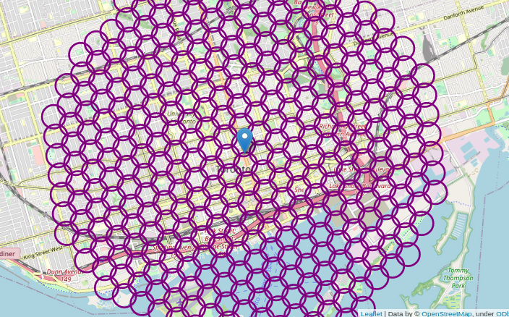
hexagonal grid of cells

Slide 6
Foursquare¶
Now that we have our location candidates, let's use Foursquare API to get info on stores in each neighborhood.
We're interested in venues in 'shop' category, but only those that are proper shops - antique shop, automative shop etc. are not direct competitors so we don't care about those. So we will include in out list only venues that have 'clothing shop' in category name, and we'll make sure to detect and include all the subcategories of specific 'clothing stores' category, as we need info on clothing stores in the neighborhood

Slide 7
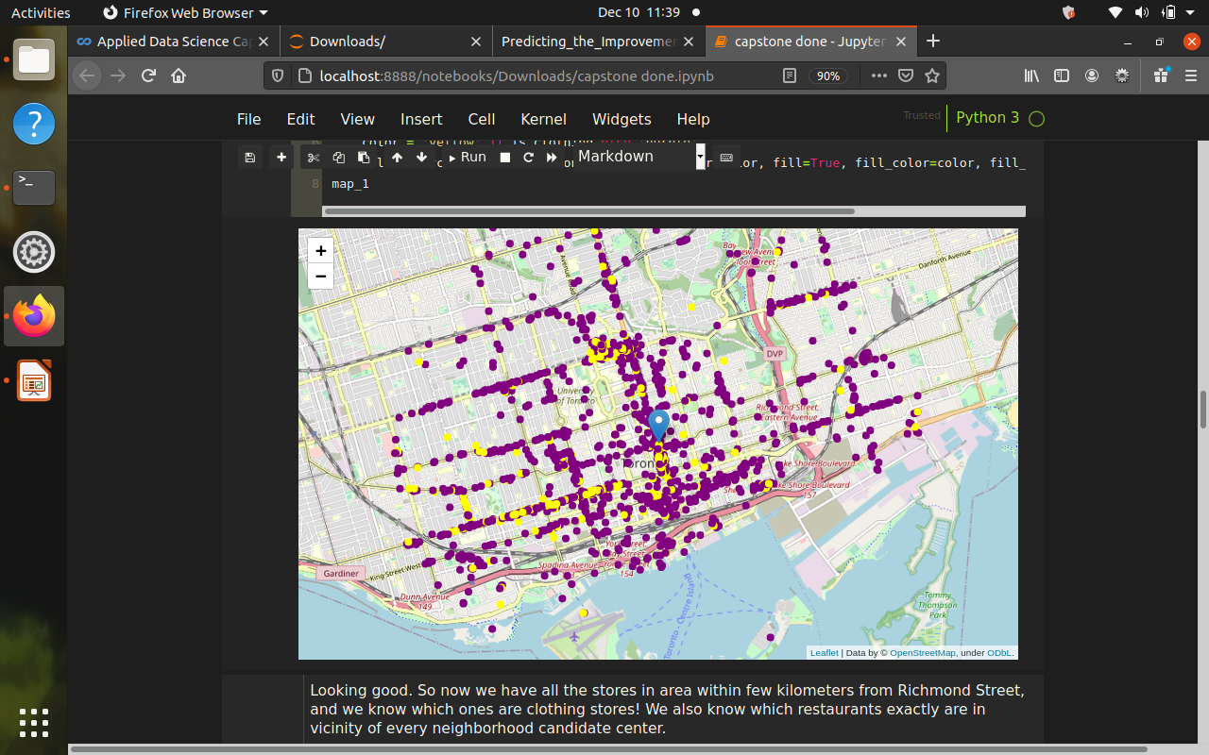

Slide 8
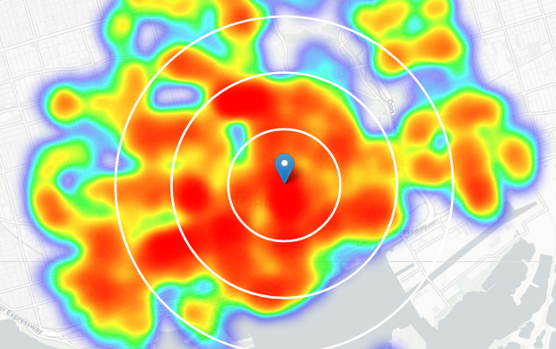
OK, so on average clothing store can be found within ~500m from every area center candidate. That's fairly close, so we need to filter our areas carefully!

Slide 9
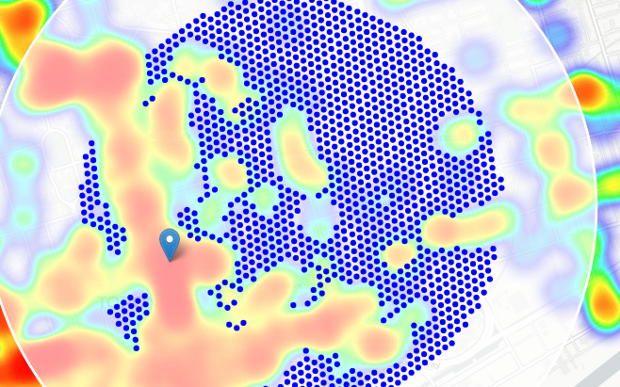
Let us now filter those locations: we're interested only in locations with no more than two stores in radius of 250 meters, and no clothing stores in radius of 400 meters.

Slide 10
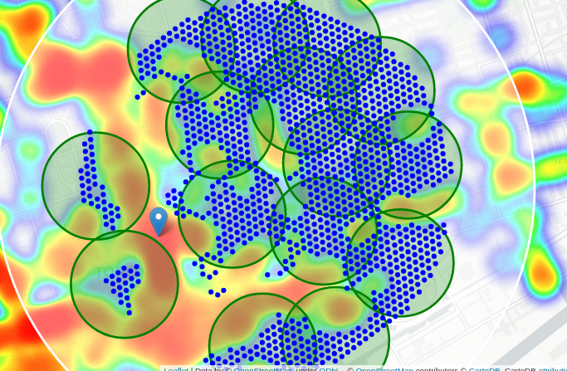
K-means clustering model

Slide 11
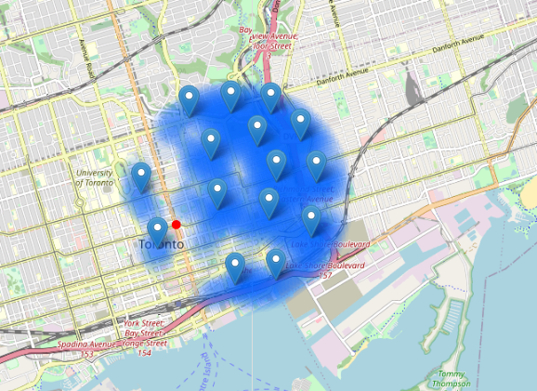
Result and Conclusions

Slide 12
Final decission on optimal store location will be made by stakeholders based on specific characteristics of neighborhoods and locations in every recommended zone, taking into consideration additional factors like attractiveness of each location (proximity to park or water), levels of noise / proximity to major roads, real estate availability, prices, social and economic dynamics of every neighborhood etc.

